Slide 1
COMP SCI 1103/2103 Algorithm Design & Data Structure Recursion 4
School of Computer Science

Slide 2
Previously on ADDS
Recursion
Checklist
Recursive helper function
Tail recursion
Memoisation
Indirect recursion

Slide 3
Overview
In this lecture we will:
Discuss Tabulation
Discuss the algorithmic strategy of Dynamic Programming
Fibonacci
Counting Coin Problem
Notes:
Designing a program is often a difficult task. There is no complete set of rules and no algorithms to tell you how to write programs.
Program design is a creative process.

Slide 4
Improving efficiency - Tabulation
Similar to Memoization, but Tabulation calculates and stores all of the sub-results in advance, not just those produced in the recursion.
What do we do in Tabulation?
Again, break the problem down to some smaller subproblems
solving each of them once
storing the solutions into some data structure (usually a table).
Tabulation (bottom up) – useful if the sub values are all going to be used
Memoization (top down) – useful if not all sub values are going to be used
Both of these approaches are ways to implement Dynamic Programming (breaking the problem down into smaller problems and storing results)

Slide 5
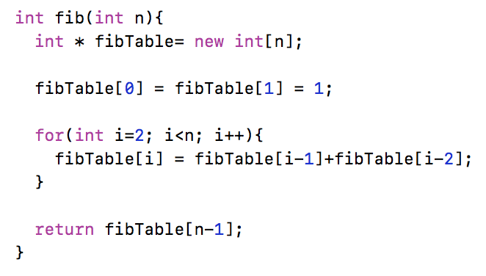
Example 1
Let’s look back to the Fibonacci number
Fib(n) = Fib(n-1) + Fib(n-2)
How can we apply Dynamic Programming?
Is this memoisation or tabulation? Will there be a difference?

Slide 6
Example 2
Counting Coins
Given a value n, if we need n cents, how many ways can we make the change?
Assume infinite supply of each kind of coins
int coinValue[] = {5, 10, 20, 50, 100, 200};
How many configurations can you find for 20 cents?
What is the result for value n when you include i (0<=i<=maxPossible) coins of value x?
The result for n-i*x, without considering coins of value x for that.

Slide 7
Counting Coins Recursive Algorithm
int facevalue[] = {5, 10, 20, 50, 100, 200};
int count(int n, int coinIndex){
if (n == 0)
return 1;
if (n < 0)
return 0;
if (coinIndex >= 6 )
return 0;
int counter = 0;
for (int i = 0; i<= n/facevalue[coinIndex]; i++)
counter += count(n - i*facevalue[coinIndex], coinIndex+1);
return counter;
}
How can we also do this loop recursively?

Slide 8
Example 2 version 2
Counting Coins
Given a value n, if we need n cents, how many ways can we make the change?
Assume infinite supply of each kind of coins
int coinValue[] = {5, 10, 20, 50, 100, 200};
What is the result for value n when you include 0 or 1 coins of value x?
The results for n and next type of coins + the results for n-x and coins of value x again.

Slide 9
Counting Coins Recursive Algorithm v2
int facevalue[] = {5, 10, 20, 50, 100, 200};
int countV2(int n, int coinIndex){
if (n == 0)
return 1;
if (n < 0)
return 0;
if (coinIndex >= 6 )
return 0;
return countV2(n, coinIndex+1) + countV2(n-facevalue[coinIndex], coinIndex);
}

Slide 10
Example 2
 | Coin types used
 |  |  |  |  |  | 5
 |  |  |  |  | 10 | 10
 |  |  |  | 20 | 20 | 20
 |  |  | 50 | 50 | 50 | 50
 |  | 100 | 100 | 100 | 100 | 100
Total Amt | 200 | 200 | 200 | 200 | 200 | 200
0 | 1 | 1 | 1 | 1 | 1 | 1
5 | 0 | 0 | 0 | 0 | 0 | 1
10 | 0 | 0 | 0 | 0 | 1 | 2
15 | 0 | 0 | 0 | 0 | 0 | 2
20 | 0 | 0 | 0 | 1 | 2 | 4
25 | 0 | 0 | 0 | 0 | 0 | 4
30 | 0 | 0 | 0 | 0 | 2 | 6
35 | 0 | 0 | 0 | 0 | 0 | 6
?

Slide 11
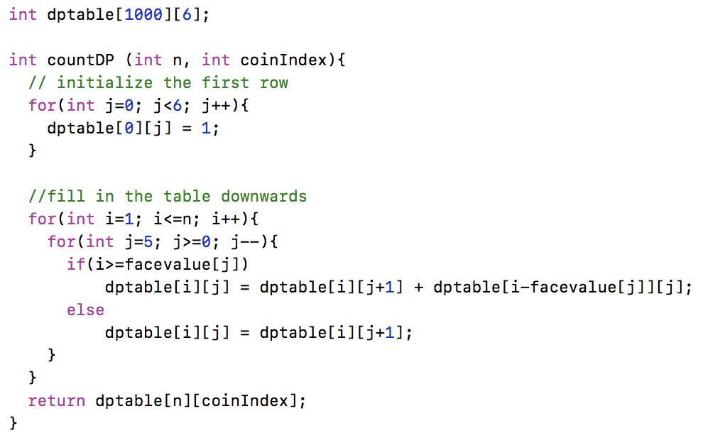
Counting Coins with DP

Slide 12
Dynamic Programming
DP is just about filling table.
All in advance for tabulation
‘On the fly’ (as generated) for memoisation
DP is not always better!
Memory use for table
CPU time to create table and lookup values
If you don’t reuse the saved values often, these costs will outweigh the benefit from saved recursive calls and perform worse!

Slide 13
Summary
Recursion is a useful tool for understanding problems and producing readable solutions.
In designing recursive functions, we need to keep in mind the two important factors of recursion
Base cases
Recursion relationship
Indirect recursion
Harder to track and control
Dynamic programming
Fill out some tables and use the values recursively

Slide 14
Notes:
Save as a PowerPoint Show and upload to your MyUni course.
Before you upload the PPS customise slides and indicate where students will find them.

